Slide 1

Java for Beginners Intermediate
Level
7
Mr. Teasdale

Slide 2
Levels of Java coding
1: Syntax, laws, variables, output
2: Input, calculations, String manipulation
3: Selection (IF-ELSE)
4: Iteration/Loops (FOR/WHILE)
5: Complex algorithms
6: Arrays
7: File management
8: Methods
9: Objects and classes
10: Graphical user interface elements

Slide 3
Files
There are two types of files in computing:
Text files (that contain ASCII/Unicode characters) – e.g. TXT, CSV
Random Access Files (that contain binary objects) – e.g. JPG, MP3

Slide 4
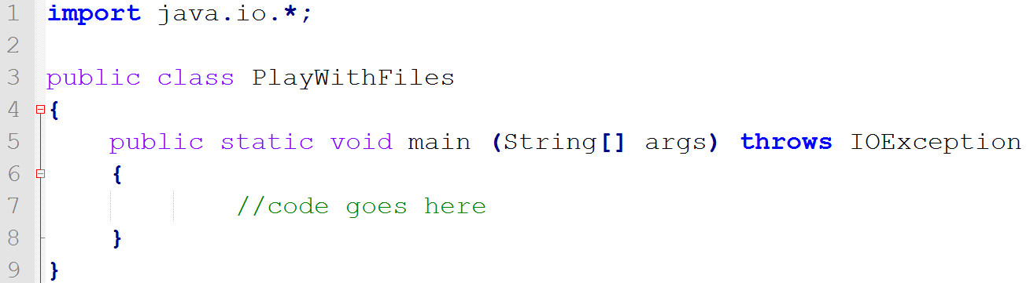
Setting up the file connection
Steps to remember:
Import: java.io.*
Throw away any IOExceptions (throws IOException) that could potentially occur in the main method

Slide 5
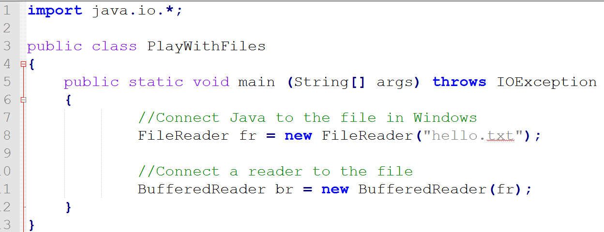
Connecting to the file
Steps to remember:
First add a File Reader
Then add that File Reader to a Buffered Reader

Slide 6

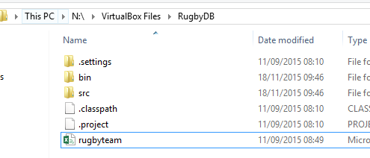
Where do I store the text file?
Store the file in the MAIN project folder (not in BIN or in SRC)

Slide 7
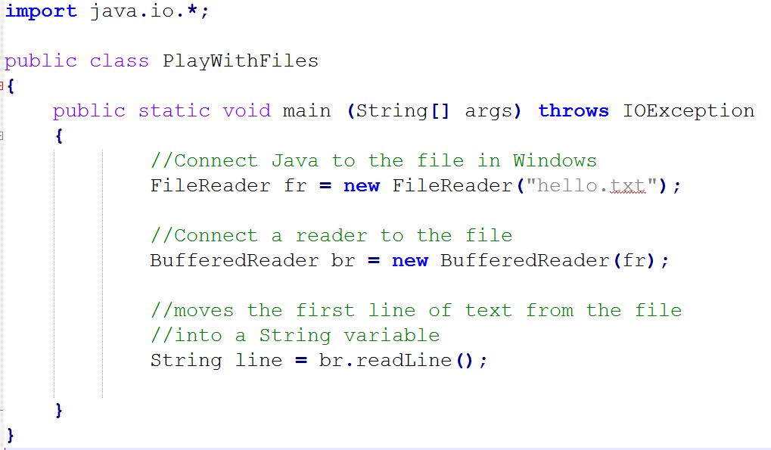
How do I read from the file?
ALL INPUT IS ALWAYS STRING!

Slide 8
Useful strategy to know
Sometimes you might want to read in data like this:
23, 45, 56, 93, 23, 35
Suggested strategy:
Read in the line in to a String
Split the String into an array
Convert the values into ints

Slide 9
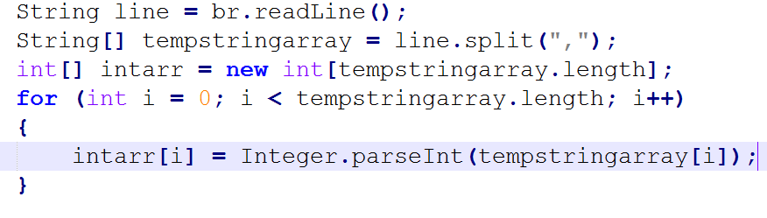
In Java that would be:
Which reads as…
Read the first line from the file in to a String variable called line.
Split the line variable into an String array called tempstringarray
Create an integer array called intarr of the same size as tempstringarray
Loop through for all the values in tempstringarray
Convert each value from a String to an int and store it in the new integer array at the same index point.

Slide 10
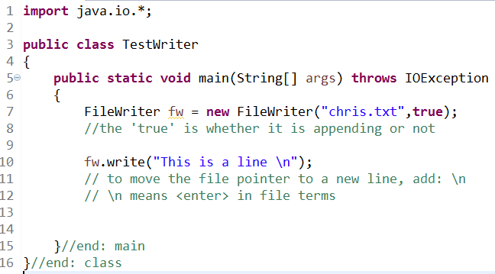
Writing to a file
No buffer is used this time. You write directly to the file.

Slide 11
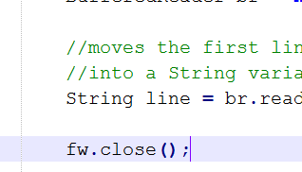
In the end, always .close()

Slide 12
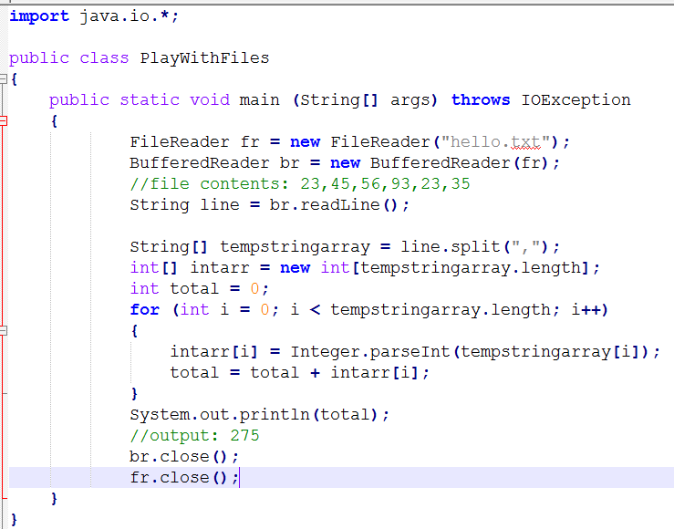
Example of adding numbers in a file

